Slide 1
DIY PROJECT Group 15
HOME AUTOMATION (voice controlled)
OBJECTIVE
To control Home Appliances with voice commands to help handicapped and aged people that will enable them to control Home appliances easily.

Slide 2

TEAM INTRODUCTION
AKSHAT SHARMA (PROJECT EXECUTION & HARDWARE PART)
DEVENDER (PPT PREPARATION & VEDIO EDITING)
SALONI KUMARI(CODING & CIRCUIT DIGRAM)
GOUTAM(PLANING, RESEARCH & BUDGET)

Slide 3

ACTIVITY PLAN
29 Jan.
PLANNING & BUDGET PREPARATION BY 29 JANUARY
2 Feb.
CIRCUIT DIGRAM BY 2 FEBRUARY
11 Feb.
CODE BY 11 FEBRUARY
15 Feb.
PPT PREPARATION BY 15 FEBRUARY
19 Feb – 25 Feb
EXECUTION OF PROJECT, HARDWARE ASSEBLING & TESTING
25 Feb - 28 feb
Video making and editing.

Slide 4

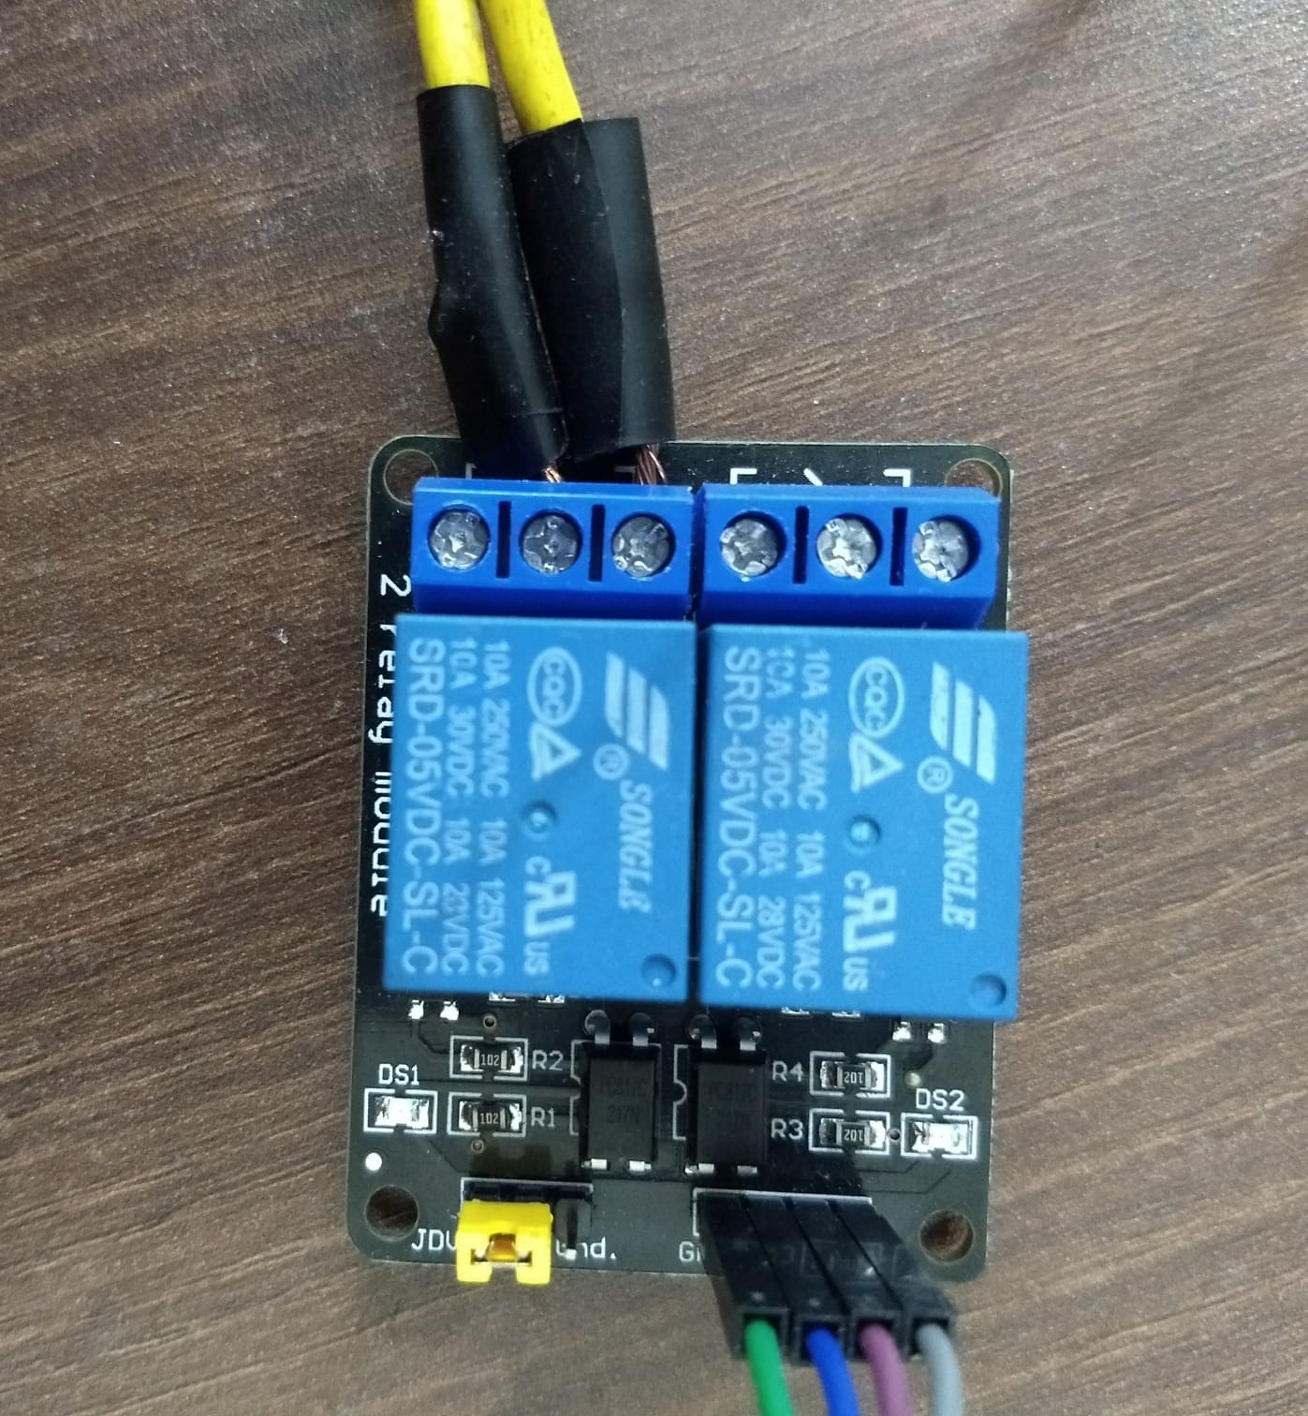
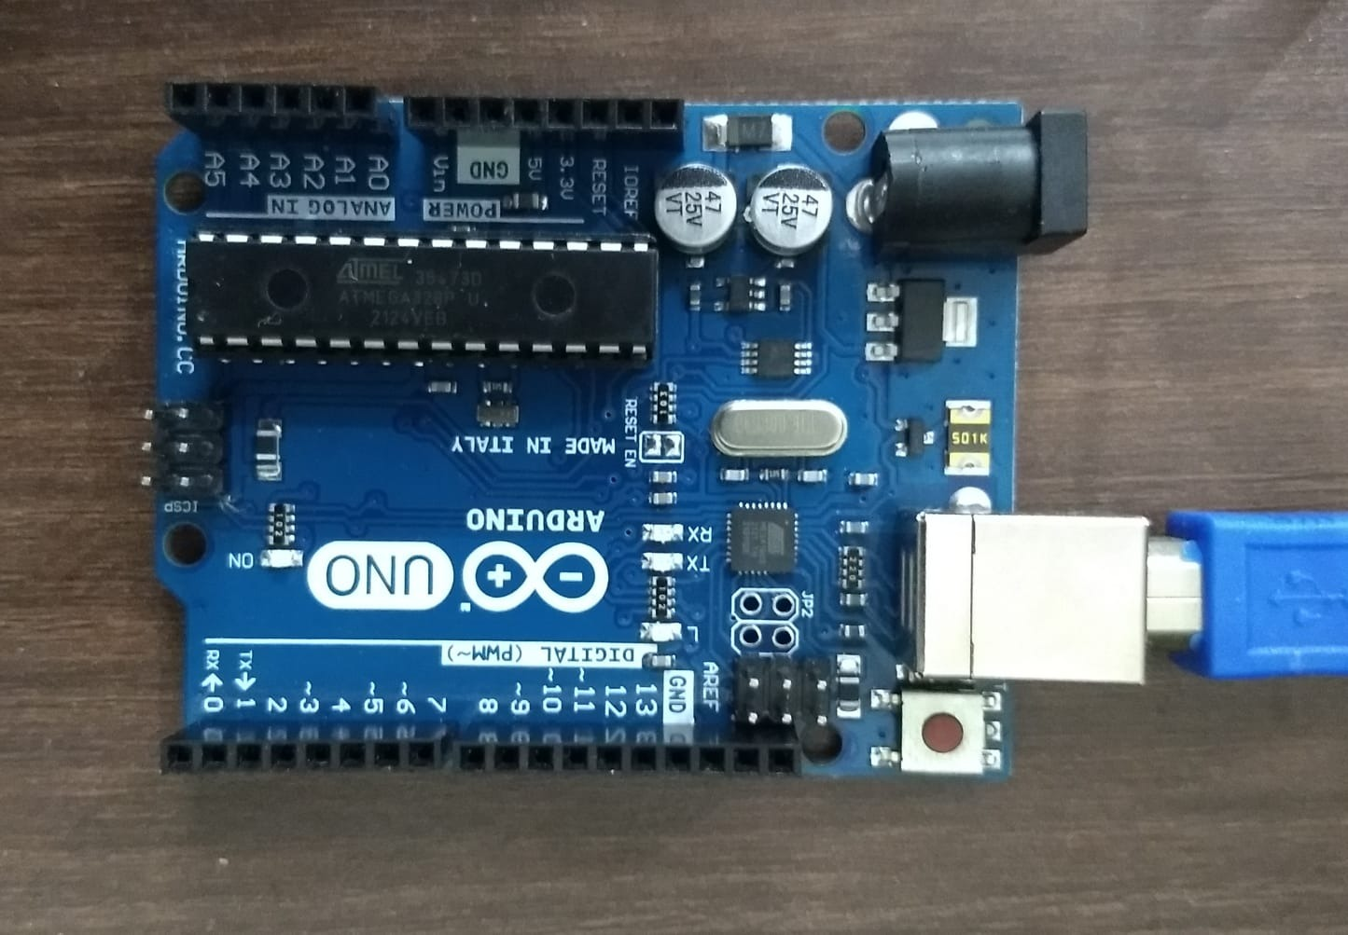
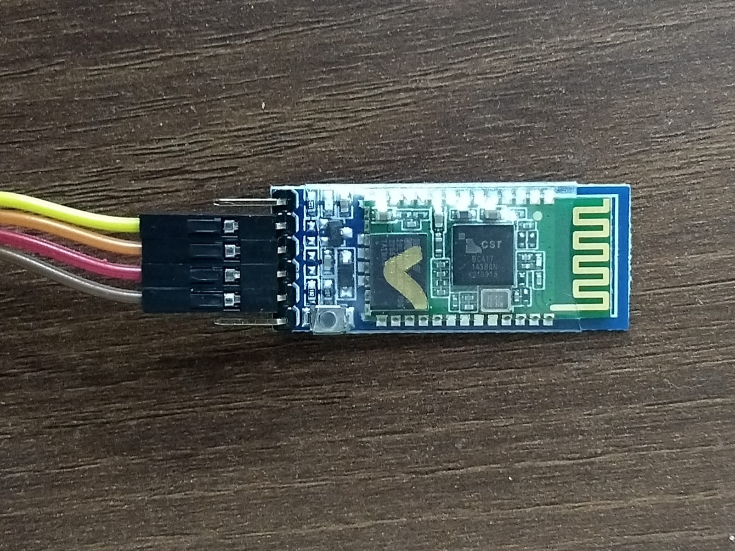
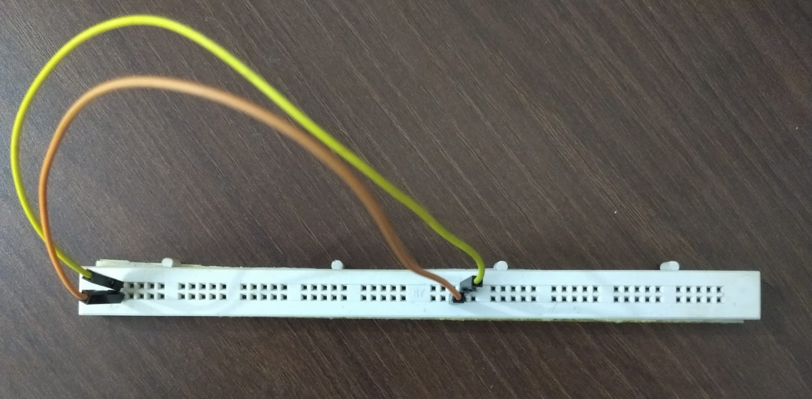


COMPONENTS
ARDUINO UNO + USB WIRE
BLUETOOTH MODULE (HC-05)
2C RELAY MODULE
BREAD BROAD + JUMPER WIRE
LED BULB
Wi-Fi EXTENDER

Slide 5
COMPONENTS COST
ARDUINO UNO + USB WIRE =Rs 770
2C RELAY MODULE = Rs 120
BLUETOOTH MODULE (HC-05)= Rs 400
JUMPER WIRE = Rs 114
HALF BREAD BROAD = Rs 175
TOTAL COST = Rs 1579
COST PER PERSON = Rs 395

Slide 6
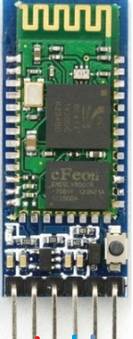

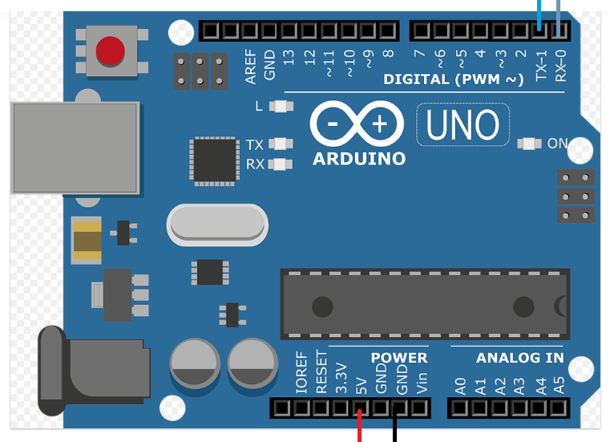
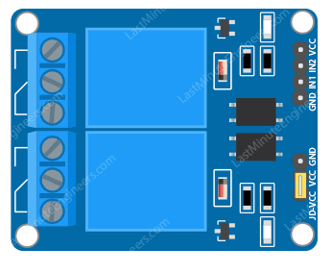
Received signals are processed by Arduino
Transmits the command to Bluetooth module
Voice command
Based on the commands, Arduino controls the relay module which in turn controls the connected appliances.

Slide 7
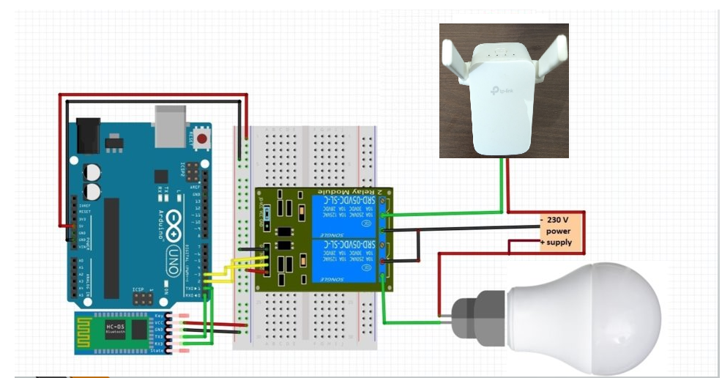
CIRCUIT DIAGRAM

Slide 8
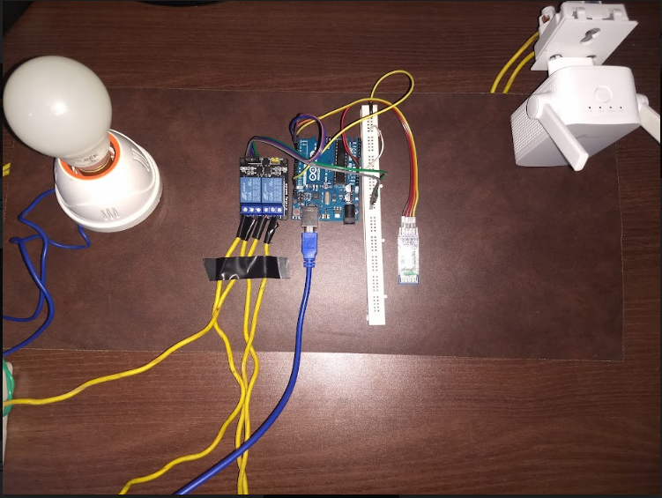

Slide 9
FUTURE SCOPE
Voice controlled home automation system can be further modified for even controlling speed of the fan and intensity of light.
We can use Wi-Fi module instead of Bluetooth for home automation approach. It is faster, more reliable, and more secure than Bluetooth.

Slide 10
CONCLUSION
This project help us to design home automation which is easy to use (especially for handicap and old peoples) and has good reliability, increase energy efficiency and home security.

Slide 11
THANK YOU

